Slide 1
How to use this supplement (delete before the talk)
Slides 8–18 are Sterling's EMC 2026 originals — animations intact. Copy with “Keep Source Formatting.”
Every video on these slides is a real embedded clip; click to play, no internet needed.
Working slides (this one, and the last two) are planning aids, not talk slides.
Notes:
Not a talk slide. Built by presentation/build_supplement_deck.py.

Slide 2
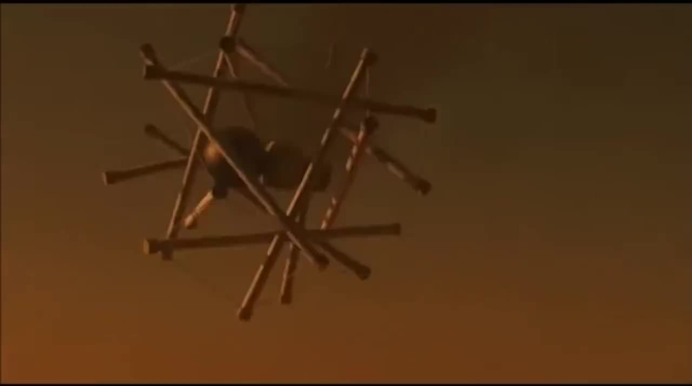
A tensegrity lander can hit the ground at highway speed, bounce, and still get up.
NASA Super Ball Bot / NIAC Titan mission concept — 20 s excerpt. Credit: NASA.
Notes:
Open here. Play the clip silently, say nothing for the first five seconds. Then the scope line: a printed PLA-TPU T3 prism is our proxy for developing the workflow, not flight hardware.

Slide 3
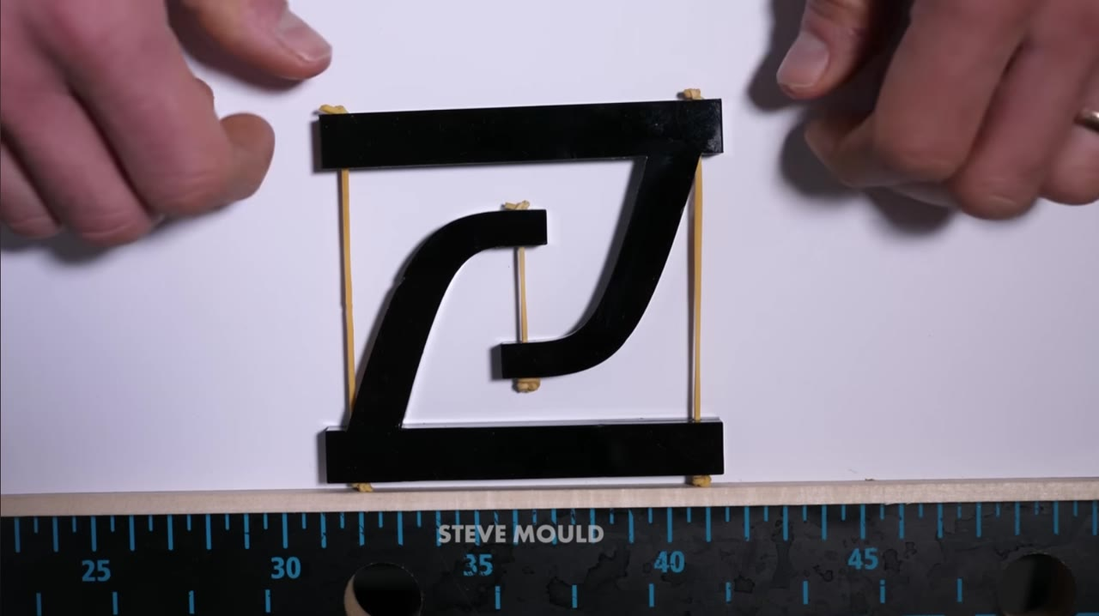
A tensegrity holds itself up with rigid struts that never touch, floating in a net of cables.
Steve Mould, “Tensegrity Explained” (youtube.com/watch?v=0onncd0_0-o) — 35 s excerpt, played with sound, used with on-screen credit.
Notes:
BACKGROUND, first beat. Play the whole 35 s with the sound up and stay quiet — the narration does the teaching, and the 2D model is the fastest way to make the mechanism obvious to anyone who has never seen a tensegrity.
Watch for: the model standing with nothing glued or hinged; the push; the spring back. That elastic return is the whole reason a tensegrity is interesting as an energy absorber.
The earlier 18 s silent crop cut the push-and-recovery off the end, which threw away the part that teaches. Source: the Box folder shared on PR #84.

Slide 4
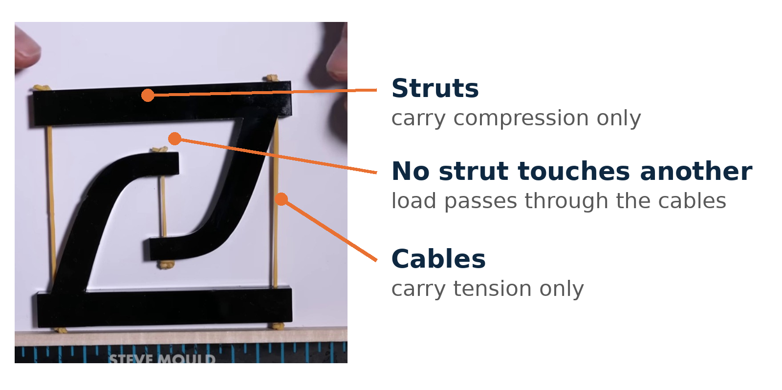
Every load path is either pure compression in a strut or pure tension in a cable — nothing in between.
Still from the same clip — Steve Mould, “Tensegrity Explained” (youtube.com/watch?v=0onncd0_0-o).
Notes:
BACKGROUND, second beat. Freeze the model and name the parts, so the vocabulary is in place before the tensegrity-inspired caveat later on.
Say: this is why a tensegrity can be light and still stiff — no member ever sees a bending moment, and the cables set the stiffness. It is also why the geometry matters so much: change a strut length or a cable pre-tension and the whole response changes, which is what makes it an optimization problem.
This is the mechanism visual the mock audience said the grad student needed in order to tell a tensegrity from a lattice.

Slide 5
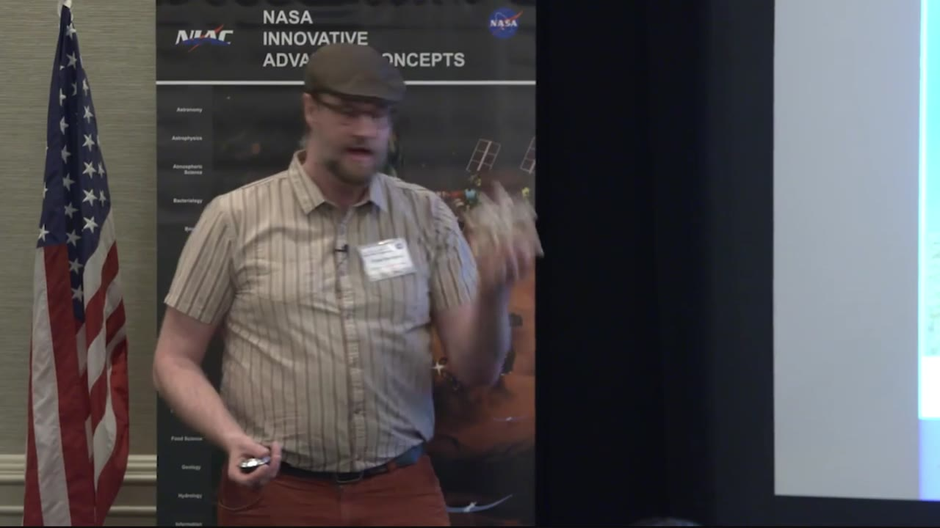
NASA's idea started with a baby toy: throw it at the floor, nothing breaks — that is a landing robot.
Adrian Agogino, NASA Ames — “NASA 360 Talks: Super Ball Bot” (youtube.com/watch?v=0eC4A2PXM-U), first 16 s. Credit: NASA.
Notes:
PLAY THIS ONE WITH SOUND — the audio is the slide. He holds a tensegrity baby toy, says they are made as baby toys because they are almost impossible to break, throws it at the floor, and lands on “hey, that's a landing robot.” Say nothing over it; pick up with our own version of that idea. He reaches “planetary landers” verbatim a few seconds later in the source video if you ever want the longer cut (24.5-31 s).

Slide 6
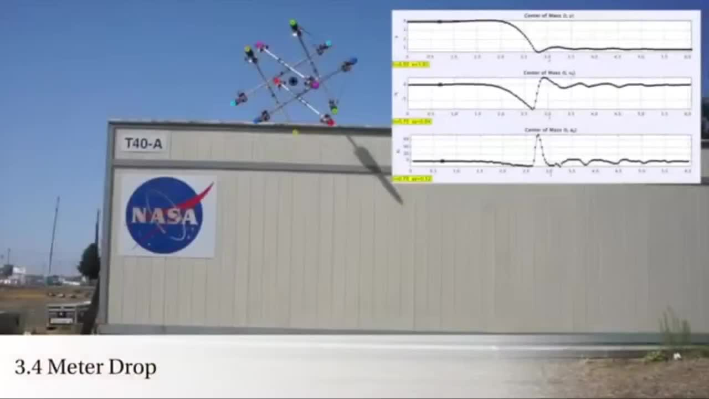
Crushable honeycomb absorbs one impact; a tensegrity structure survives drop after drop.
SUPERball v2 3.4 m drop — IEEE Spectrum / NASA Ames (youtube.com/watch?v=hkzeE6BVNIk), 10 s excerpt.
Notes:
This is the reusability argument Sterling asked for: the same hardware takes the next drop. It is also why our own campaign can re-test a specimen instead of consuming it.

Slide 7
Tensegrity impact structures already exist — every one of them was designed and assembled by hand.
NASA SUPERball v2 — hand-built, one design, no optimization loop
Davami 2025 — printed tensegrity, characterized but not optimized
Gu & Dotov — tensegrity crutch tip: the application pull is real
TODO before freeze: verify citations against manuscript/references.bib.
Notes:
Three names, ten seconds. The point is not a literature review; it is that the design step is still manual everywhere.

Slide 8
Nobody closes the loop: print the structure, drop it, and let the measured data choose the next design.
TODAY
Hand-tuned geometry
Simulation, rarely validated
One-off demonstrations
THIS WORK
The drop test is the objective
Trade-offs learned from shock data
One printer, one tower, one loop
Notes:
This is the motivation-to-gap transition. Do not read the columns; point left, point right, move on.

Slide 9
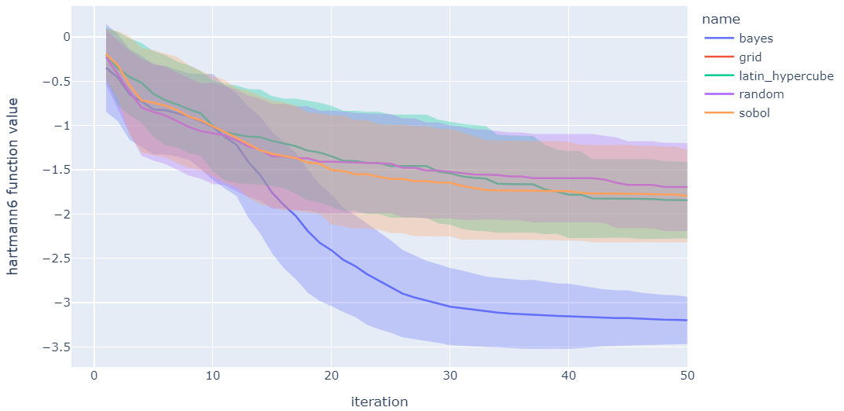
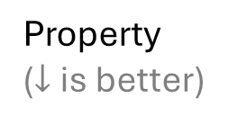
Bayesian optimization is a machine learning technique that works well in the limit of low data and many variables
Property
($↓$ is better)
Design of Experiments
(Traditional)
Bayesian Optimization
0
50
Experiment #
Baird et al. Matter (2022)
Notes:
, primarily because we are almost always in a very low data regime with high-dimensional search spaces. You'll get a funny look or a curt remark from a reviewer if you try to train a neural network on a few dozen points. These tend to overfit and have poor uncertainty quantification. Bayesian optimization, on the other hand, is incredibly good at quantifying uncertainty and balancing exploration of new designs with fine-tuning existing ones.

Slide 10
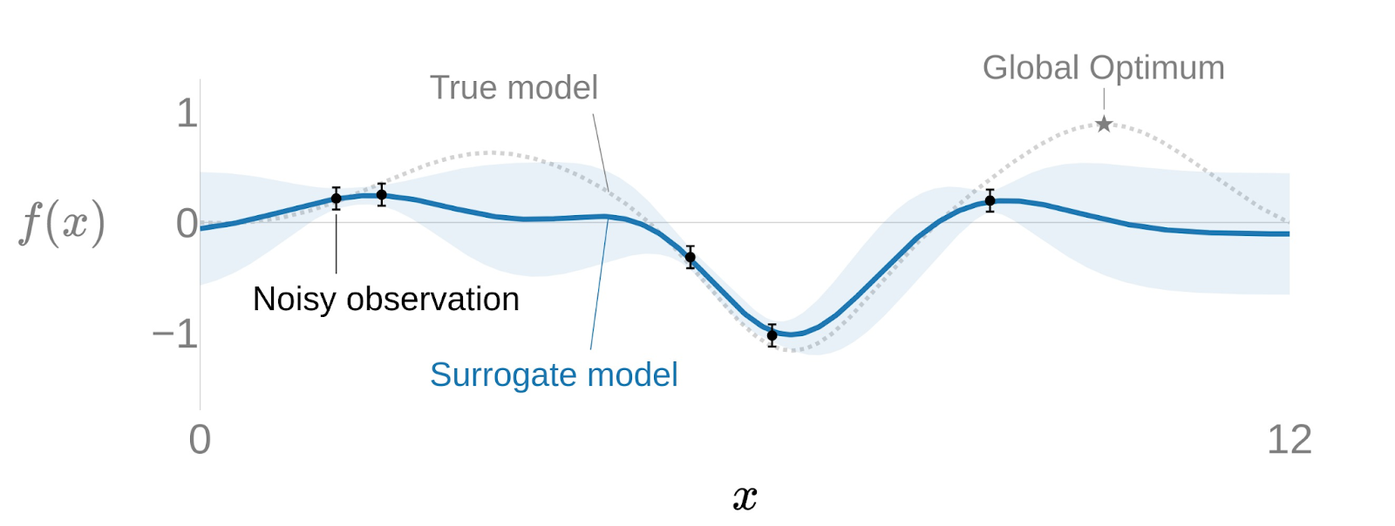
A surrogate model predicts properties and quantifies uncertainty

Slide 11
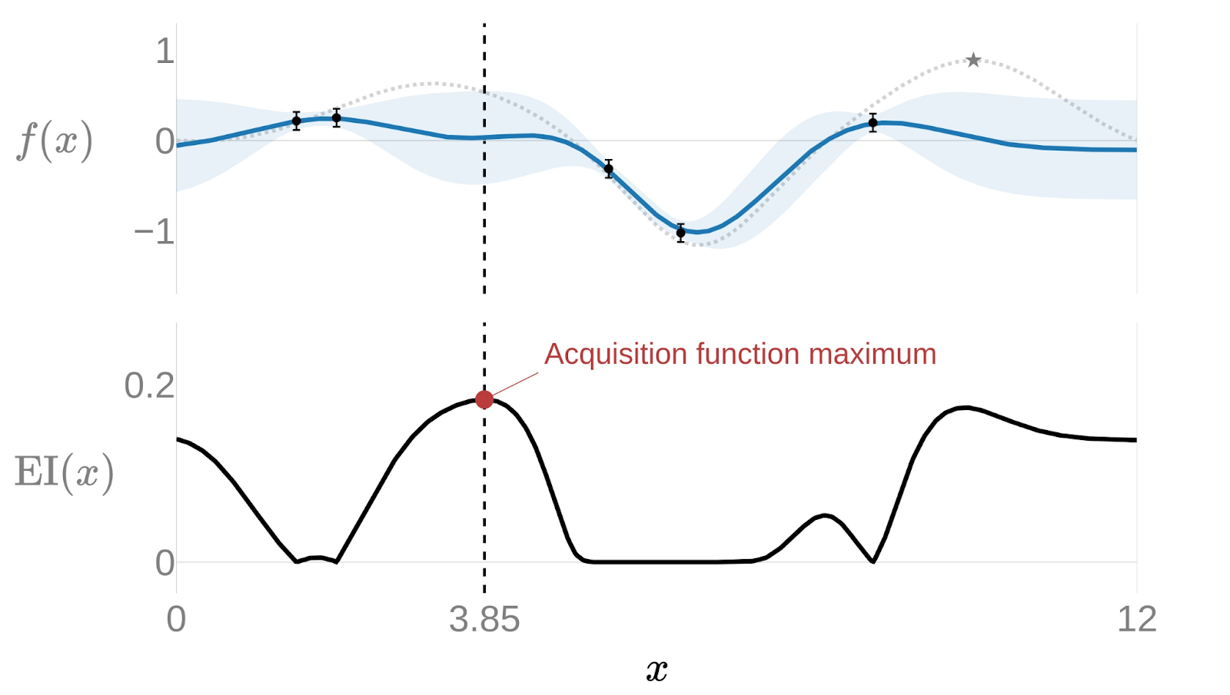
The acquisition function guides how to select the next experiment (in this case, neither the max predicted nor the max uncertainty)

Slide 12
This Bayesian optimization loop continues iteratively (1) add data, (2) fit surrogate model (3) optimize acquisition function

Slide 13
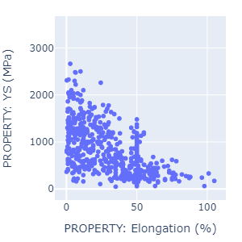
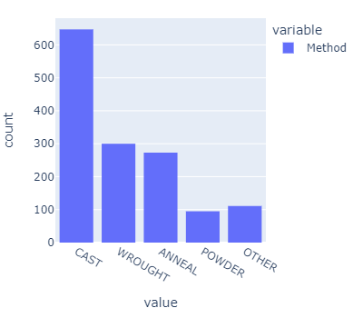

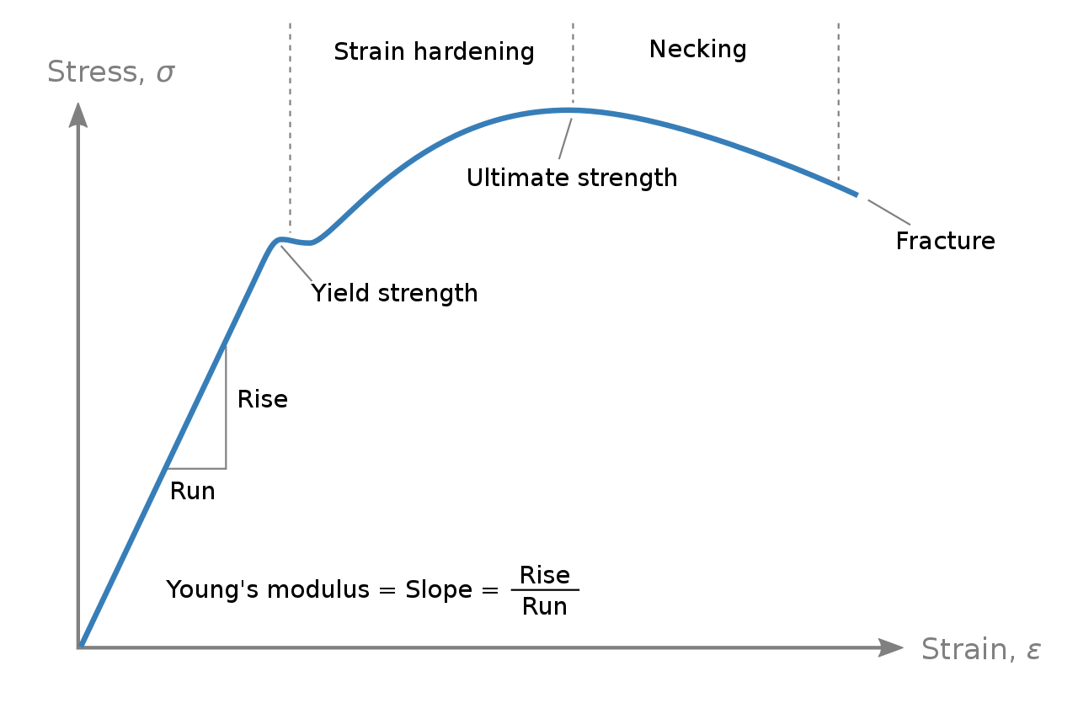

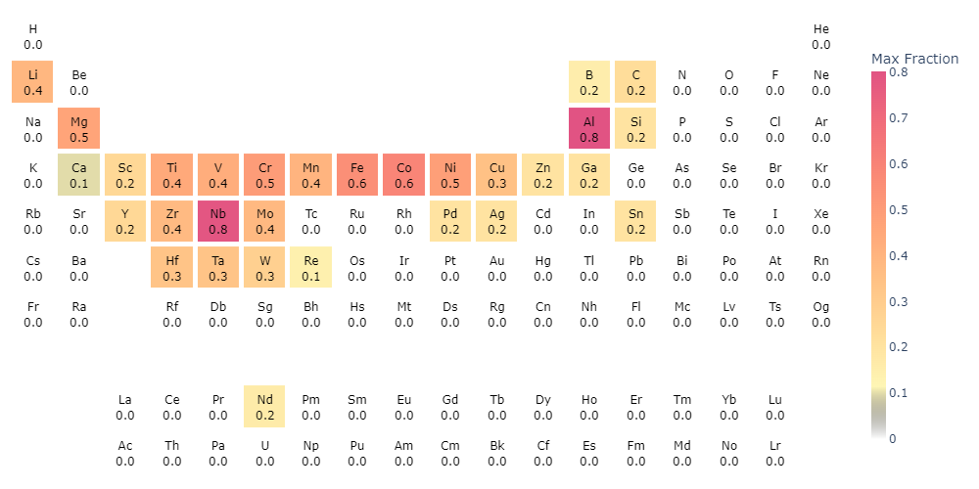
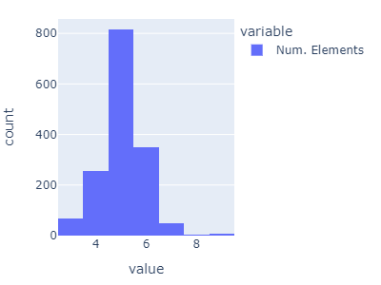
Real-world materials discovery tasks such as alloy design require more than “vanilla” optimization
Multi-task
Multi-objective
Mixed Continuous/Categorical
Compositional Linear Constraint
$$x_{\text{Al}}+x_{\text{Si}}+x_{\text{Nb}}+…+x_{\text{Sn}}=1.0$$
NchooseK
nonlinear constraint
High-dimensional

Slide 14
Real-world materials discovery tasks such as alloy design require more than “vanilla” optimization
Multi-task
Multi-objective
Mixed Continuous/Categorical
Compositional Linear Constraint
NchooseK
nonlinear constraint
High-dimensional
Notes:
Wave my magic wand to rearrange the text

Slide 15
Real-world materials discovery tasks require more than “vanilla” optimization
Multi-task
Single | Multi
Multi-objective
Single | Multi
Mixed Continuous/Categorical
Continuous | Cont. + Categorical
Compositional Linear Constraint
No Constraint | Linear Constraint
High-dimensional
Low dim. | High dim.
NchooseK
nonlinear constraint
No Constraint | Nonlinear Constraint

Slide 16
Real-world materials discovery tasks require more than “vanilla” optimization
Basic
Multi-task
Single | Multi
Multi-objective
Single | Multi
Mixed Continuous/Categorical
Continuous | Cont. + Categorical
Compositional Linear Constraint
No Constraint | Linear Constraint
High-dimensional
Low dim. | High dim.
NchooseK
nonlinear constraint
No Constraint | Nonlinear Constraint

Slide 17
Real-world materials discovery tasks require more than “vanilla” optimization
Advanced
Multi-task
Single | Multi
Multi-objective
Single | Multi
Mixed Continuous/Categorical
Continuous | Cont. + Categorical
Compositional Linear Constraint
No Constraint | Linear Constraint
High-dimensional
Low dim. | High dim.
NchooseK
nonlinear constraint
No Constraint | Nonlinear Constraint

Slide 18
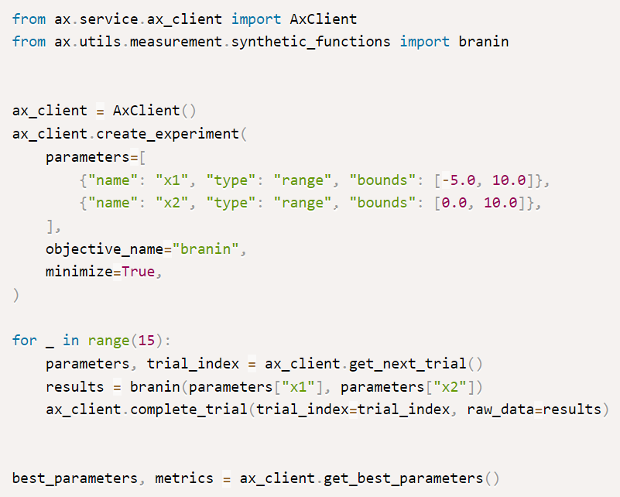
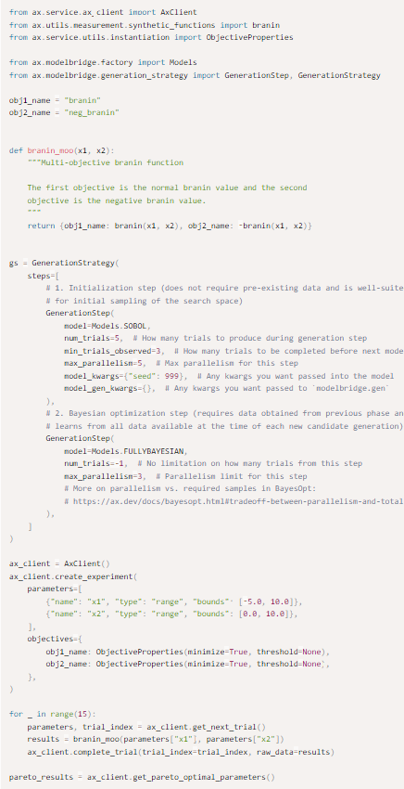
Honegumi lets you quickly create advanced BO examples
Basic
Advanced
Single obj. | Multi obj.
Single obj. | Multi obj.
Single task | Multi task
Single task | Multi task
Continuous | Cont. + Cat.
Continuous | Cont. + Cat.
No Constraint | Linear
No Constraint | Linear
Low dim. | High dim.
Low dim. | High dim.
No Constraint | Nonlinear
No Constraint | Nonlinear
Pairs well with LLMs
21 lines
62 lines
3x

Slide 19
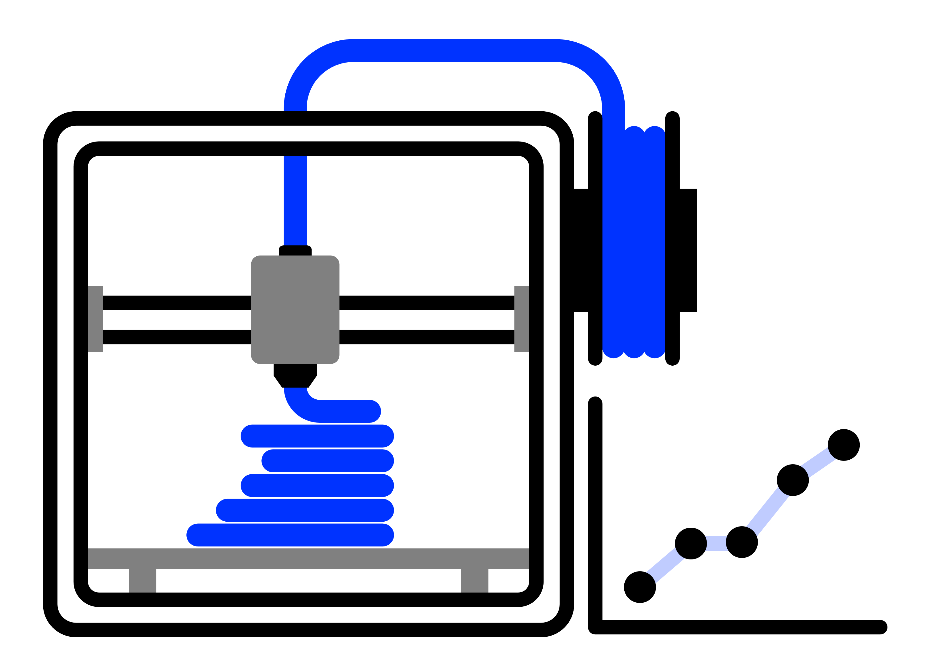
Maximize the strength of a 3D printed part as a function of internal geometry and printer settings

Slide 20
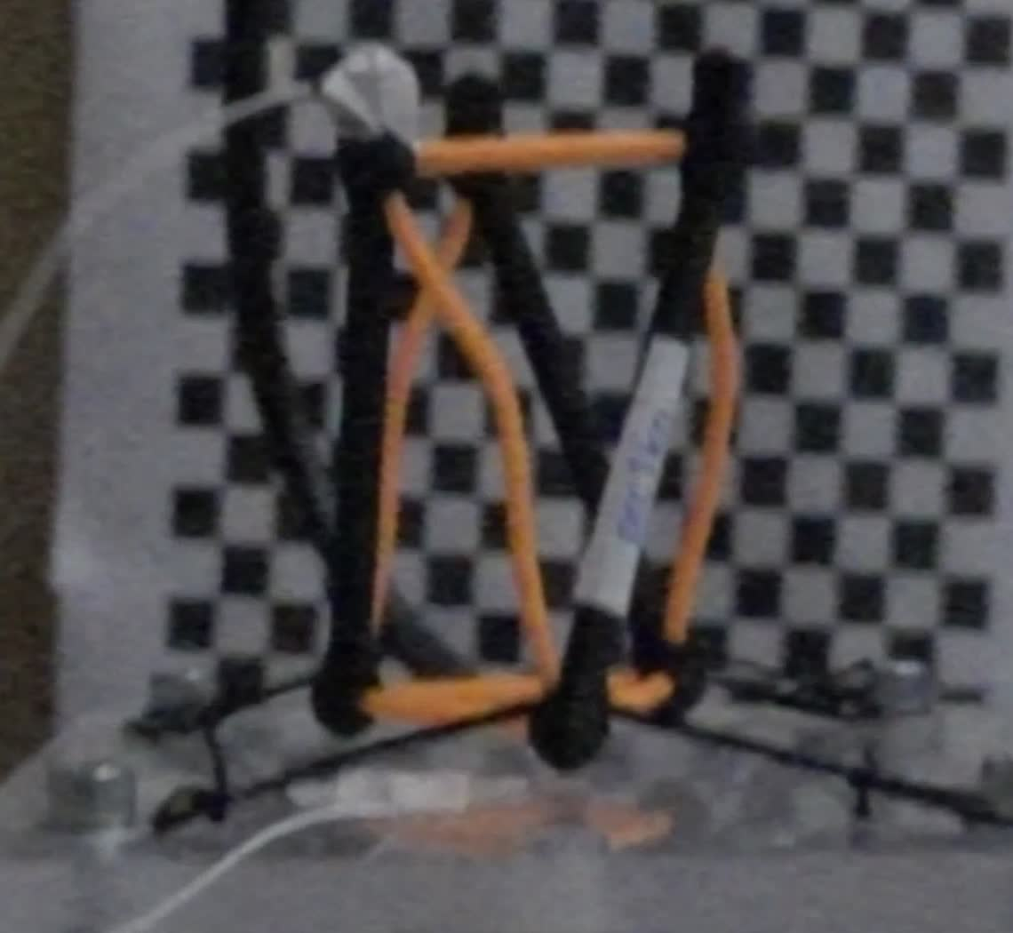
Honest caveat, in the same breath: as printed, these are tensegrity-inspired, not true tensegrity.
The black TPU members are not pre-tensioned — and they stretch.
Next: pre-tensioned prints, plus hand-built true-tensegrity validation specimens.
Printed PLA–TPU T3 prism, prc1kn — frame from our own 959 fps drop footage.
Notes:
Say this the moment multi-material printing appears — do not let the audience discover it in Q&A. Pair it with the path forward (issue #87 pre-tensioning) so it reads as scope, not weakness.

Slide 21
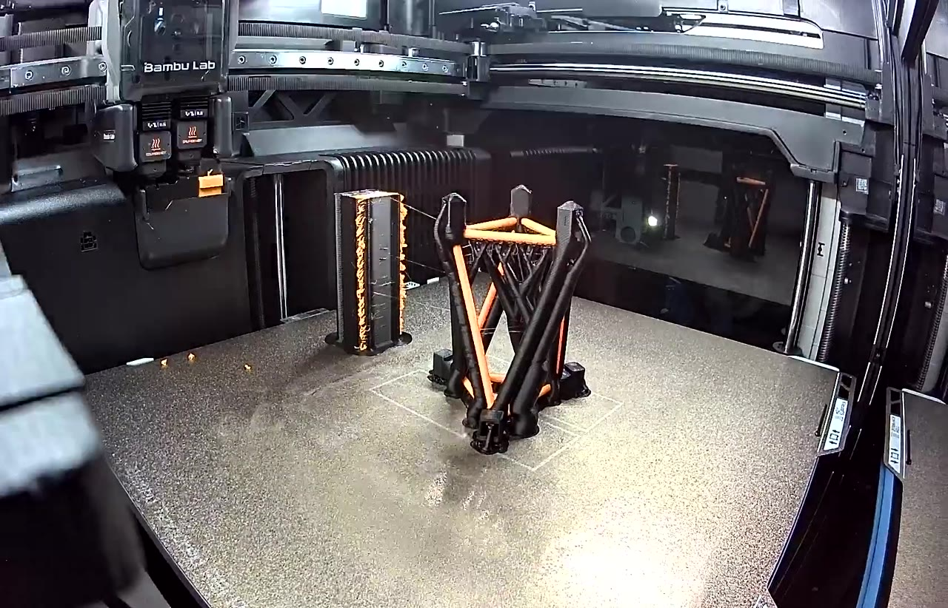
One machine lays down the rigid struts and the stretchy cables in a single build.
Bambu Lab H2D, two materials: PLA struts, TPU cables
No jig, no knots, no post-assembly step
Our own print timelapse, TT3_01 — 16 s excerpt (youtube.com/watch?v=nQNmi-NiL5I, BYU Vertical Cloud Lab).
Notes:
Spoken line: twenty-odd minutes of printing and no assembly step is what makes a design-per-day loop possible at all. Play it once, silently.
Pulled from our own YouTube channel through the lab Raspberry Pi — the CI runner is bot-blocked by YouTube. Embedded here, so it needs no internet at the podium.

Slide 22
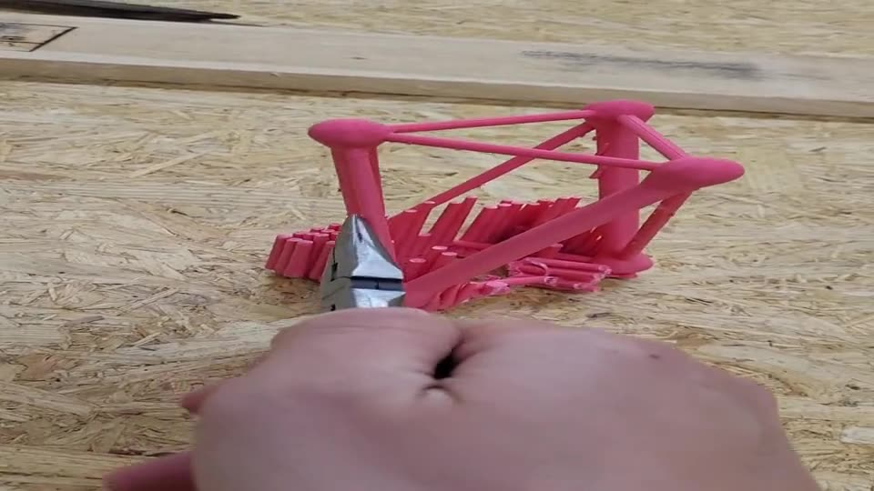
Printing it in one build is not the same as getting it out clean — supports still come off by hand.
The honest bottleneck in the loop today
Our own footage — manual support removal on a T3 prism (PR #35, 2026-06-09).
Notes:
Challenge slide, ten seconds. Say the mitigation out loud: painted manual supports and a 0.4 mm tip cut removal time, and automating this step is exactly what stands between us and a self-driving lab. Do not over-dwell; it is a caveat, not a confession.

Slide 23
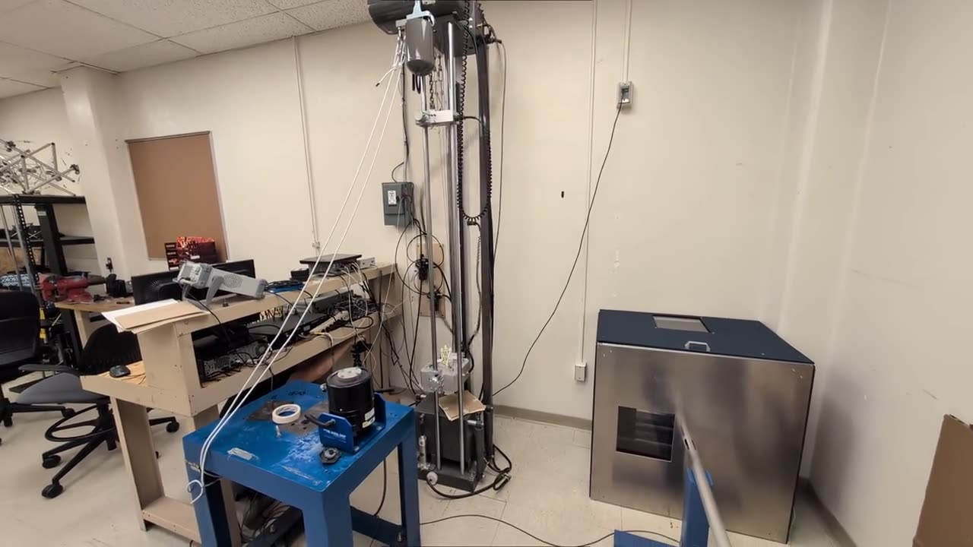
The whole experiment takes a quarter of a second — here it is in real time.
Our own footage — drop tower, BYU Smart Materials lab. Play with sound.
Notes:
PLAY THIS WITH SOUND ON. Seven seconds, real time, whole room. The bang is the point: it tells the audience how violent a millisecond-scale event this is before any plot appears. Then say the standard condition out loud — 60 in onto the same felt stack every time, repeated per specimen — and move on.

Slide 24
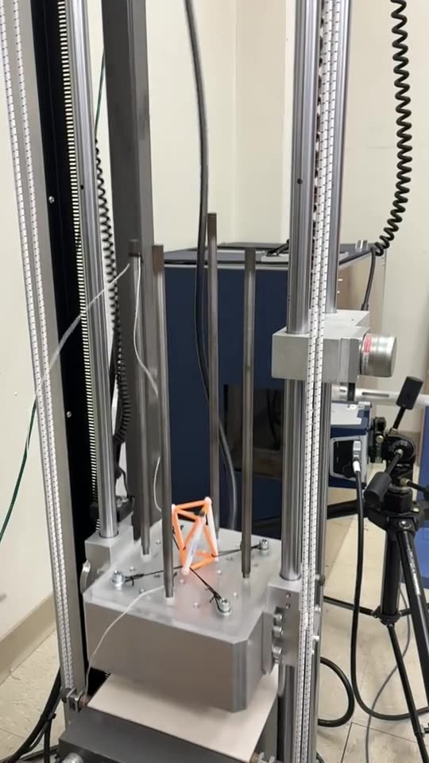
A phone in slow motion is enough to see the drop — and to hear the impact.
Free, instant, and good enough to catch setup mistakes
How we caught a specimen lifting off and a sensor coming loose
Our own footage — specimen n0jdwk, 13 in drop (PR #67). Play with sound.
Notes:
Play with sound. Roughly eight times slower than real time (1.6 s of descent for a fall that takes under 0.26 s), which is the usual 240 fps phone mode. This is the cheap instrument and it earned its place: phone slow-mo is how we caught the specimen lifting off the base plate on the bungee-assisted tower, and how we caught the accelerometer coming loose. It sets up the next two slides, which say what the fast camera is and is not for.

Slide 25
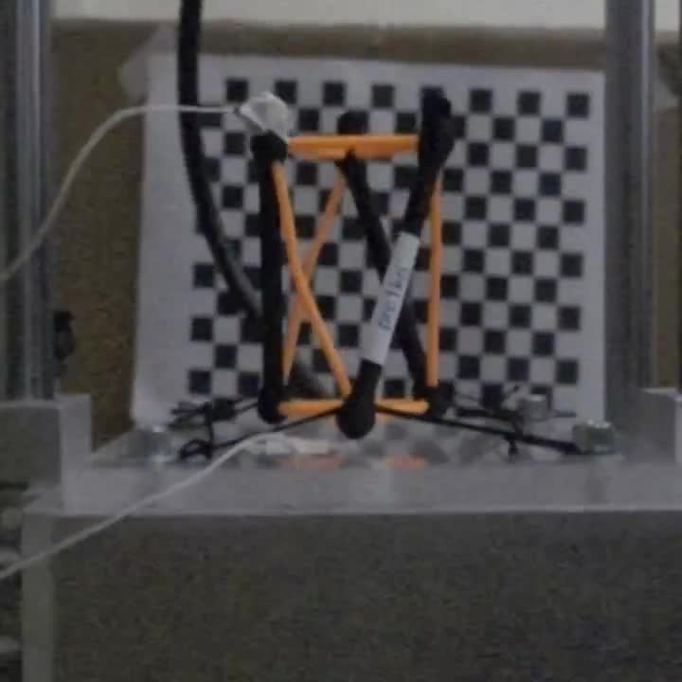
High-speed video shows the structure spring back and hold its shape.
Sony RX100 IV, 959 fps
Rebound, sag and recovery over the next 150 ms
No permanent deformation — the specimen goes back in the tower
Our own footage: prc1kn specimen, 60 in drop, 5-felt input (data/drop-tests/prc1kn-60in-5felt/video/).
Notes:
Play it once, silently, and talk about what they can see: it bounces, and it comes back intact. That is the reusability argument in our own data.
PRESENTER-ONLY, do not volunteer: one frame is 1.04 ms, so the 1.6 ms deceleration itself spans 1-2 frames — the accelerometer is what measures the pulse. Resolving compression *during* the pulse would need >=5000 fps DIC (docs/drop-test-prc1kn-video-analysis.md, section 3). Only bring this up if someone asks what the camera can resolve.

Slide 26
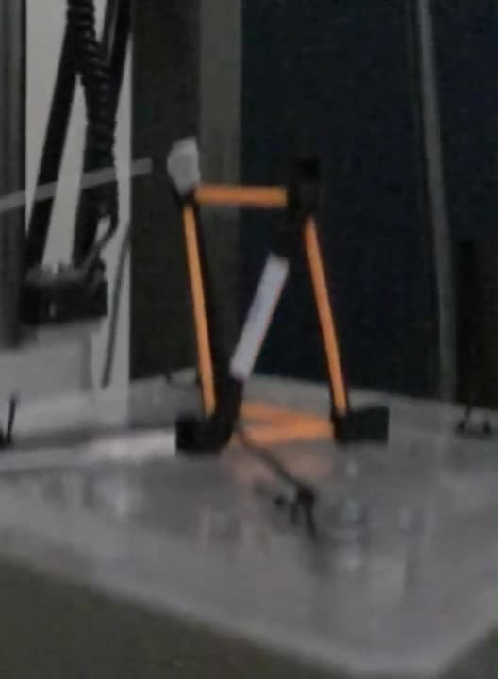
The top vertex leaves the impact at 0.7 times the speed it arrived — it springs back.
Elastic re-extension, not permanent collapse
Measured on both validation specimens; both intact afterwards
Our own 960 fps footage — specimen 7xadt6, 60 in / 5-felt validation campaign (PR #86 branch).
Notes:
This is the reusability claim made with our own data instead of NASA's, and it is squarely in the post-pulse regime the previous slide said the camera owns. Snap-back at ~0.7x impact speed with visibly intact specimens is in the 60in-5felts video writeup. Say it plainly: a crushable absorber would not do this, and it is why one specimen can serve many drops in the campaign.

Slide 27
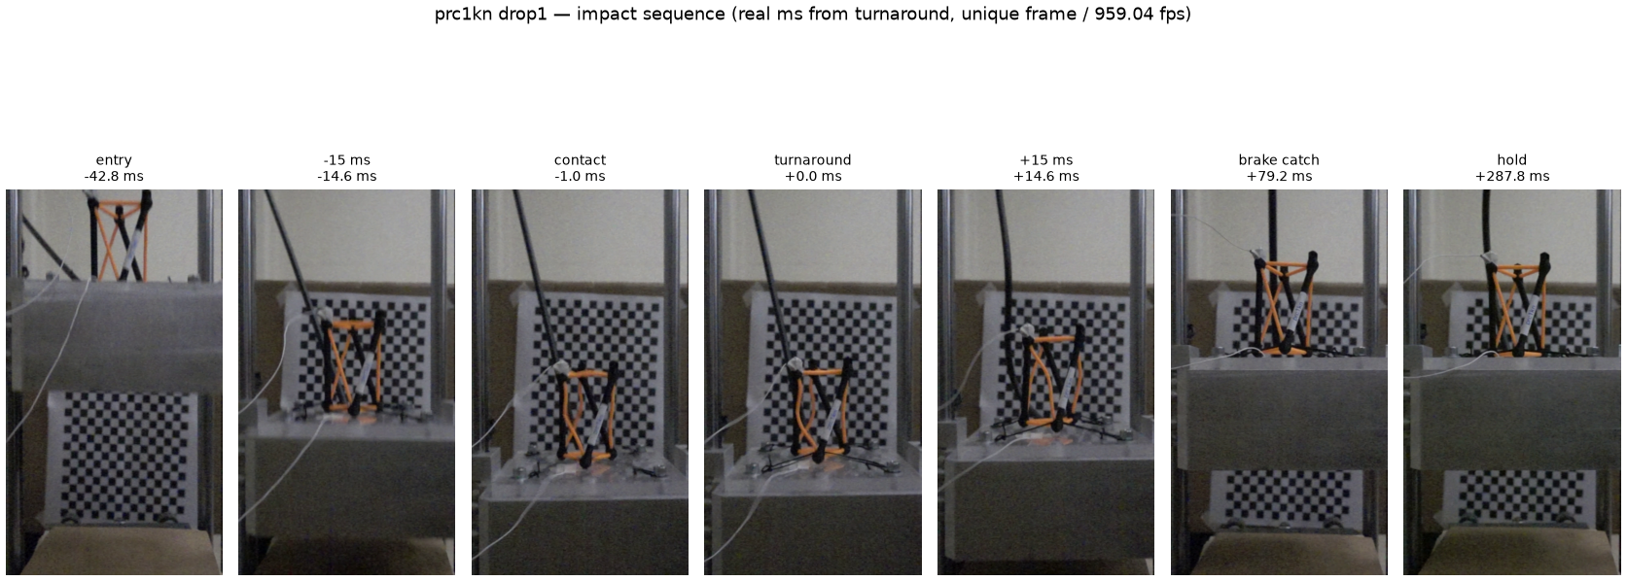
One clean shock, an elastic rebound, and the brake catches the carriage 79 ms later.
prc1kn drop 1, 959.04 fps.
Notes:
Walk it left to right in one sentence: entry, contact, turnaround, rebound, brake catch, hold. What it proves is rig physics and specimen integrity — one shock per drop, no plastic deformation, and the anti-rebound brake catching 150 mm above the stack.
PRESENTER-ONLY: contact and turnaround are adjacent frames, so do not claim the montage resolves the deceleration itself.

Slide 28
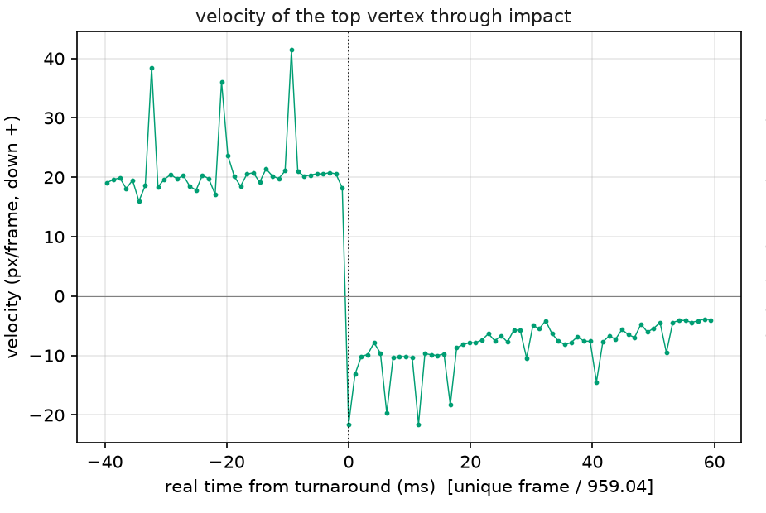
The camera measures the bounce; the accelerometer measures the force.
Camera → rebound: e* = 0.45, and the structure survives
Accelerometer → peak force, energy absorbed, compaction
Together they cover the whole event
prc1kn drop 1, 959 fps; TP4 accelerometer at 125 kHz.
Notes:
One sentence: the video tells us how much of the drop comes back, the accelerometer tells us what the payload felt. The coefficient of restitution 0.45 is a free reusability metric — it needs no pixel scale.
PRESENTER-ONLY: the objectives come from the accelerometer, not the video. And do not say the two instruments 'agree on the same drop' — the prc1kn videos were shot ~5.5 h before that DAQ campaign, so drop-level pairing is not possible (docs/drop-test-prc1kn-video-analysis.md).

Slide 29
A drop tower with an instrumented payload measures the force that actually reaches the payload.
Lansmont M23 tower · Dytran 3133A4 accelerometers
TP4 DAQ at 125 kHz — this is the instrument that sees the pulse
Standard test: 60 in drop onto 5 felts, repeated per specimen
Setup and standard conditions per the drop-test protocol (PR #86 branch); 25 kHz is the measured floor for the current pipeline (issue #89 sample-rate study).
Notes:
Add a photo of the tower here before the talk if one is available; the text is a stand-in, not a design choice.

Slide 30
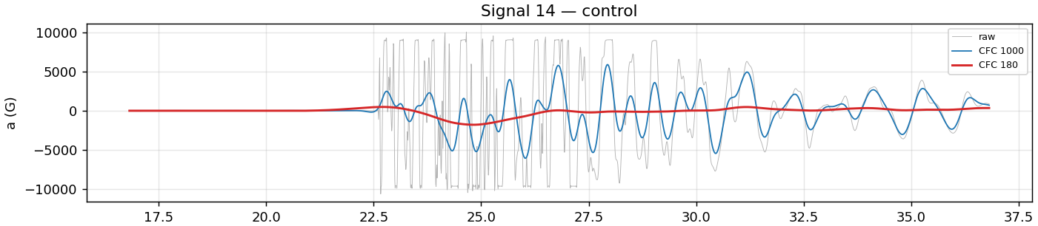
SAE J211 filtering turns raw ringing into the three numbers the optimizer actually uses.
Peak transmitted force · specific energy absorbed · compaction efficiency
Raw vs. CFC-1000 vs. CFC-180 on the same impact window.
Notes:
Do not explain the filter classes. Say: raw data ring at mounting resonance, the standard filter removes it, and what survives is the objective function.

Slide 31
One drop becomes one row of data: three numbers and the scatter around them.
Raw
1.25 MHz 4 channels
Baseline
pre-trigger median
J211 filter
CFC-180 and CFC-1000
Metrics
peak force, SEA, compaction
Replicate drops give the noise model the optimizer needs — a single drop is never one point.
scripts/analysis/drop_test_*_analysis.py on the PR #86 branch; raw CSVs committed next to every campaign.
Notes:
Answers issue #94 directly: this is the black box opened. Four steps, one sentence each. The only judgement calls are step 2 and step 3 — and both of them bit us, which is the next few slides.

Slide 32
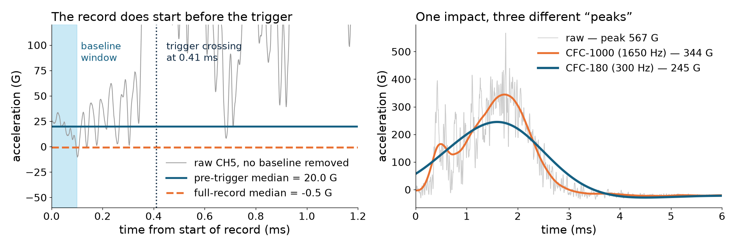
SAE J211 sets the filter, not us — and the class you pick changes the peak by a factor of two.
Same drop, same sensor: raw 567 G · CFC-1000 344 G · CFC-180 245 G
Specimen bpx68c, Signal 11 (data/drop-tests/pu-configs/). Two-pole Butterworth, forward and backward, per SAE J211-1.
Notes:
For issue #94. CFC-180 is a 300 Hz corner, CFC-1000 is 1650 Hz — the number in the class name times 1.65. Neither is more correct; CFC-180 is the automotive-crash convention for what a body feels, CFC-1000 keeps the structural ringing we need to hear the specimen. That is why our tables report both, and why moving between them changed a recommendation.

Slide 33
We report both bands because they answer two different questions.
CFC-180 · 300 Hz
“What does the payload feel?”
Smooth pulse, stable peak, the number that goes in the force constraint
CFC-1000 · 1650 Hz
“What is the structure doing?”
Keeps the 500–550 Hz specimen mode — the part that actually differs between designs
Specimen first mode measured at 519–549 Hz across the ringdown analyses in this repo.
Notes:
The honest version of the answer to Sterling's question in #94. We did not abandon CFC-180; we stopped using it as the only band, because at a 300 Hz corner the specimen's own mode is filtered away and every design looks alike. If asked which one feeds the optimizer: the constraint is CFC-180, the discrimination diagnostics are CFC-1000.

Slide 34
Our sensors lied to us first — cross-calibration caught a 5% error before it reached the optimizer.
A mis-entered sensitivity made channel 5 read 0.953× channel 4.
Channel 1 was clipping at the highest drops and we could not see it.
Fix: regress every channel against every other, every campaign.
Calibration story documented in PR #74.
Notes:
This is the challenge slide Sterling asked to intersperse. It buys enormous credibility: we found our own error, and the cross-check is now routine.

Slide 35
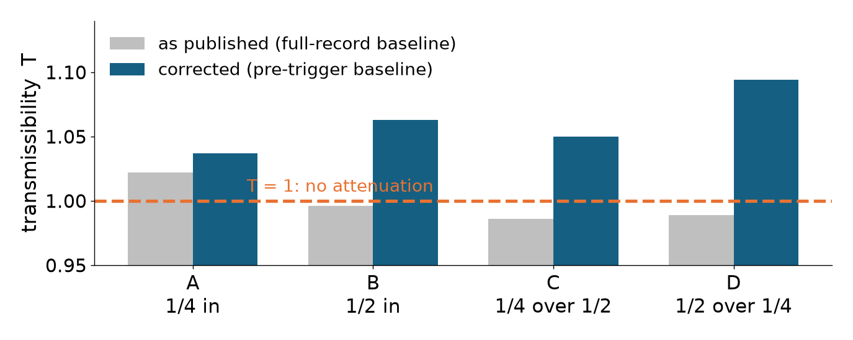
We paid an adversary to break our own analysis, and it broke it.
Our script assumed the record began at the trigger. It does not — 0.41 ms of it is pre-impact.
Verdict we adopted: none of the four — that sweep could not decide.
Edison Scientific adversarial review, task d9092c5a; recomputation reproduced independently in-repo.
Notes:
This is the credibility slide, and it is the direct answer to issue #94's “we would like to spot-check you.” Deliver it without drama: we asked for the analysis to be attacked, four of our grounds fell, we marked the document superseded rather than quietly patching it. If a reviewer asks what else it touched: two sibling analyses share the baseline, both flagged for re-run.

Slide 36
Every number on these slides can be re-derived from committed raw data.
Raw CSVs and the analysis script live beside each campaign in the repo
The filter is a published standard: SAE J211-1 / ISO 6487, channel class × 1.65 Hz
The adversarial re-analysis, its recomputed tables, and its notebook are committed too
Backup slide: repo paths and the tutorial notebook for issue #94 are listed in presentation/issue-94-analysis-slides.md.
Notes:
Backup slide for Q&A, and the place to put the Colab link once the tutorial notebook from issue #94 exists. The spoken version is one sentence: nothing here is a black box you have to take on trust.

Slide 37
Working slide: challenges and where each one gets told
Sensor sensitivity error → cross-calibration → own slide (33)
Wrong baseline window → adversarial re-analysis → own slide (34)
Camera and DAQ cover different timescales → each gets its own job → slides 24, 27
Supports still removed by hand → painted supports → slide 21
Channel clipping at high drops → headroom check → spoken on slide 28
Print defects confound specimens → replicates → Q&A backup
Cables not in tension → pre-tensioned prints → slide 19
Notes:
Planning aid. Delete before the talk.

Slide 38
Working slide: media inventory and what still needs shooting
EXTERNAL, EMBEDDED: Titan descent · 2D tensegrity · NASA toy-to-lander (sound) · SUPERball drop
OURS, EMBEDDED: print timelapse · support removal · whole-room drop (sound) · phone slow-mo (sound) · 960 fps drop · 7xadt6 snap-back
DUPLICATE: the print timelapse also opens the background addendum — keep one copy, not both
STILL NEEDED: drop-tower photo, campaign ledger and Pareto-front figures, Colab link for issue #94
Notes:
Planning aid. Delete before the talk.

